Slide 1
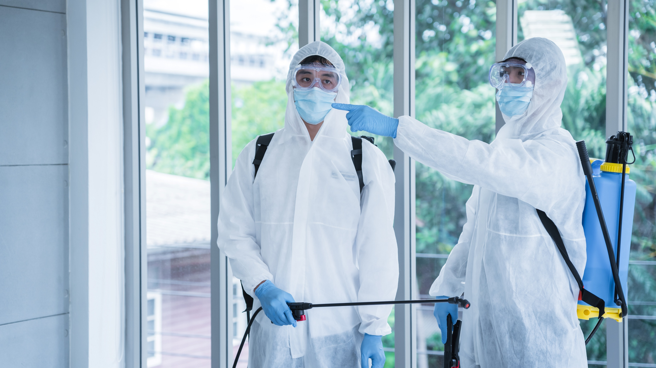
Respond to Potential and Actual Exposure to Infection Risks Within Scope of Own Role
HLTINF006 - Apply basic principles and practices of infection prevention and control (Release 1)

Slide 2
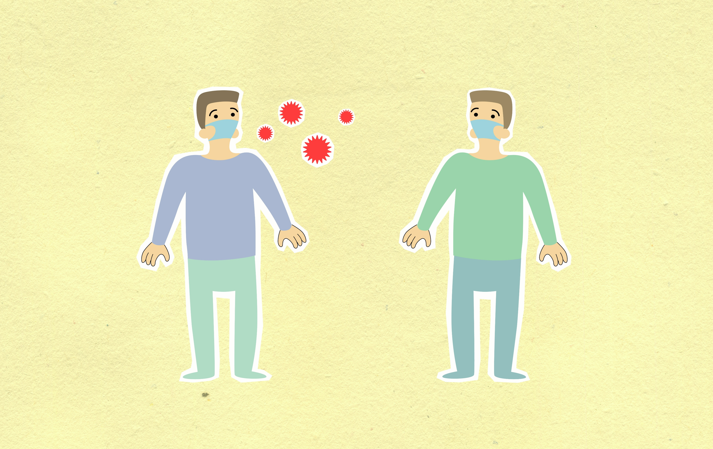
3.1 Identify, Respond to and Communicate Risk or Breach in Infection Control

Slide 3


Infection control refers to the policies and processes in place at an organisation to reduce the risk of transmitting a suspected or verified infection.
These measures vary based on the hazards and risks identified in the workplace.
Control measures is another phrase for infection control.
There are times when numerous factors have a detrimental impact on or violate these controls.
Respond to Potential and Actual Exposure to Infection Risks Within Scope of Own Role

Slide 4
These instances could be any of the following:
The potential risk of infection control
The actual risk of infection control
A breach in infection control
Respond to Potential and Actual Exposure to Infection Risks Within Scope of Own Role

Slide 5
3.1.1 Identify Potential or Actual Risk of Infection Control
To identify potential or actual risks in infection control, ask yourself the following questions:
How are the people informed about the infection control policies and procedures?
How are the infection control policies and procedures enforced?
Respond to Potential and Actual Exposure to Infection Risks Within Scope of Own Role

Slide 6
3.1.2 Identify Breach in Infection Control
A breach in infection control is the failure to follow protocols for preventing or reducing pathogen transmission.
You must have complete information when identifying the breach:
Nature of the breach
Type of procedure
Biological substances involved
Respond to Potential and Actual Exposure to Infection Risks Within Scope of Own Role

Slide 7
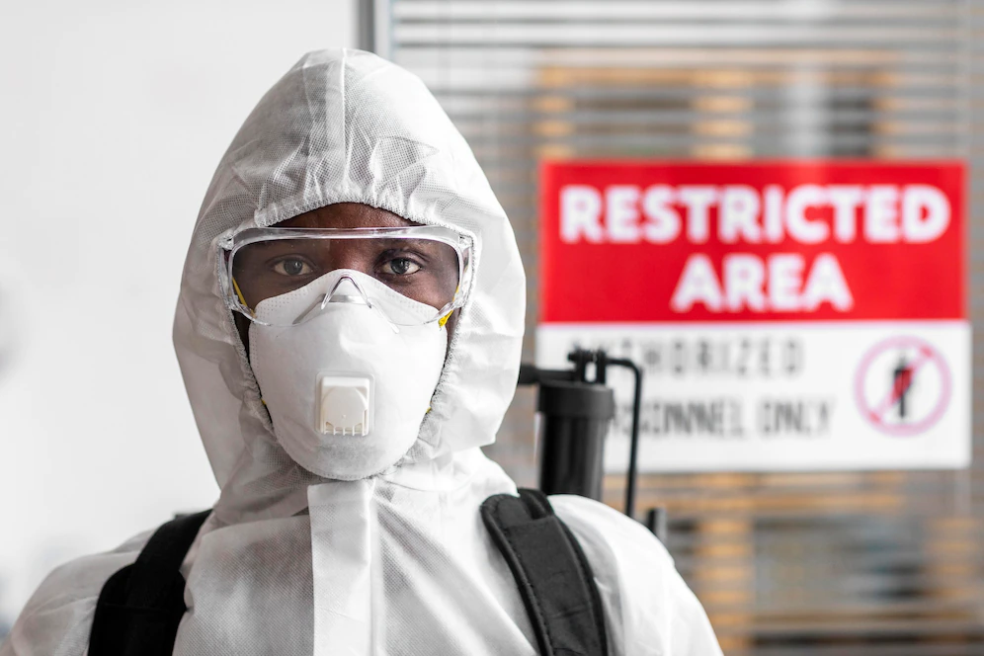
3.1.3 Respond to Potential or Actual Risk of Infection Control
Responding to a Risk of or Potential Breach in Infection Control
The following steps will assist you in carrying out this task:
Determine the identified risk’s likelihood of occurrence
Determine the identified risk’s severity of consequence
Use a risk analysis matrix
Select the control measures to minimize identified risks
Respond to Potential and Actual Exposure to Infection Risks Within Scope of Own Role

Slide 8
3.1.4 Respond to Breach in Infection Control
To respond to breaches in infection control, do the following steps:
Gather additional data
Implement IPC procedures relevant to cleaning and disinfection
Assess the condition of the people involved
Implement measures to prevent the occurrence of future breaches
Respond to Potential and Actual Exposure to Infection Risks Within Scope of Own Role

Slide 9
3.1.5 Communicate Potential or Actual Risk in Infection Control
It is a good idea to explore scenarios for dealing with actual or potential infection risks in the form of a workplace discussion.
Different studies and scenarios can thus be examined when determining how to assign the likelihood of occurrence for an infection control breach.
Communication is also essential in determining the best risk-reduction techniques.
When discussing this issue with your coworkers, follow your company's policies and procedures.
The goal is to select the optimal control measure option.
Respond to Potential and Actual Exposure to Infection Risks Within Scope of Own Role

Slide 10
3.1.6 Communicate Breach in Infection Control
The following are examples of appropriate persons to notify about an infection control breach:
Infection control professionals
Risk management
Local and state health departments
Affected healthcare providers
Relevant licensing or regulatory agencies
Respond to Potential and Actual Exposure to Infection Risks Within Scope of Own Role

Slide 11

3.2 Manage Risks According to Relevant Guidelines

Slide 12
Assessing Risks According to Industry and Organisational Guidelines
Risk assessment methods must adhere to the industry's recommendations.
These recommendations cover the following:
The current legislation requiring a hazard or risk to be controlled in a specific way
A code of practice that details a way of controlling a hazard or risk that applies to your situation
The well-known and effective control measures in your industry that are suitable to your workplace conditions
Respond to Potential and Actual Exposure to Infection Risks Within Scope of Own Role

Slide 13

Ensure that the risk assessment methods below are carried out in accordance with industry standards:
Identification of the severity of harm caused by infection hazards
Evaluation of the effectiveness of existing control measures in addressing risks
Identification of the likelihood of harm occurring
Respond to Potential and Actual Exposure to Infection Risks

Slide 14
Taking Immediate Action According to Industry and Organisational Guidelines
It could be any of the following:
Eliminating risks
Reducing risks by substitution, isolation or engineering protocols
Reducing risks through administrative protocols
Reducing risks through PPE
Respond to Potential and Actual Exposure to Infection Risks Within Scope of Own Role

Slide 15
Consider the following recommendations to assist you in deciding which control measure is best suited to handle the identified risk:
Look for information about suitable controls
Refer to the findings in your risk assessment
Cost of the control measure
Respond to Potential and Actual Exposure to Infection Risks Within Scope of Own Role

Slide 16
The Australian Guidelines set the standard for risk management systems in various organisations.
These are some examples:
Organisational support for risk management
Effective communication
Respond to Potential and Actual Exposure to Infection Risks Within Scope of Own Role

Slide 17

3.3 Report to and Consult with Relevant Authorities About Breaches in Infection Control and Risk Management

Slide 18
3.3.1 Communicate any Breach in Infection Control and Risk Management Strategies to the Supervisor, Manager or Responsible Authority
Communicating a Breach in Infection Control
In most cases, communicating breaches in infection control necessitates informing supervisors, managers, or relevant authorities.
In general, you must perform the following to report an infection control breach:
Make a verbal report
Make a written report
Respond to Potential and Actual Exposure to Infection Risks Within Scope of Own Role

Slide 19

Communicating a Breach in Risk Management Strategies
If you notice someone not following the risk management protocols, you can individually raise your concerns with your supervisor.
You can also file a written report explaining the risk-related concerns you have seen.
Respond to Potential and Actual Exposure to Infection Risks Within Scope of Own Role

Slide 20
Make sure to include the answers to the following questions in your report:
What are the risks that you have identified in your workplace?
When did you discover the existence of these risks?
In which areas or locations did you discover these risks?
Who are the staff or colleagues who contributed to these risks?
Why do you think these risks must be addressed?
Respond to Potential and Actual Exposure to Infection Risks Within Scope of Own Role

Slide 21
3.3.2 Seek Advice on Actions Required Following a Breach in Infection Control
Here are some tips when seeking guidance on infection control and risk management issues:
Create your own suggested plan of action
Choose your timing
Be specific
Be respectful
Respond to Potential and Actual Exposure to Infection Risks Within Scope of Own Role

Slide 22
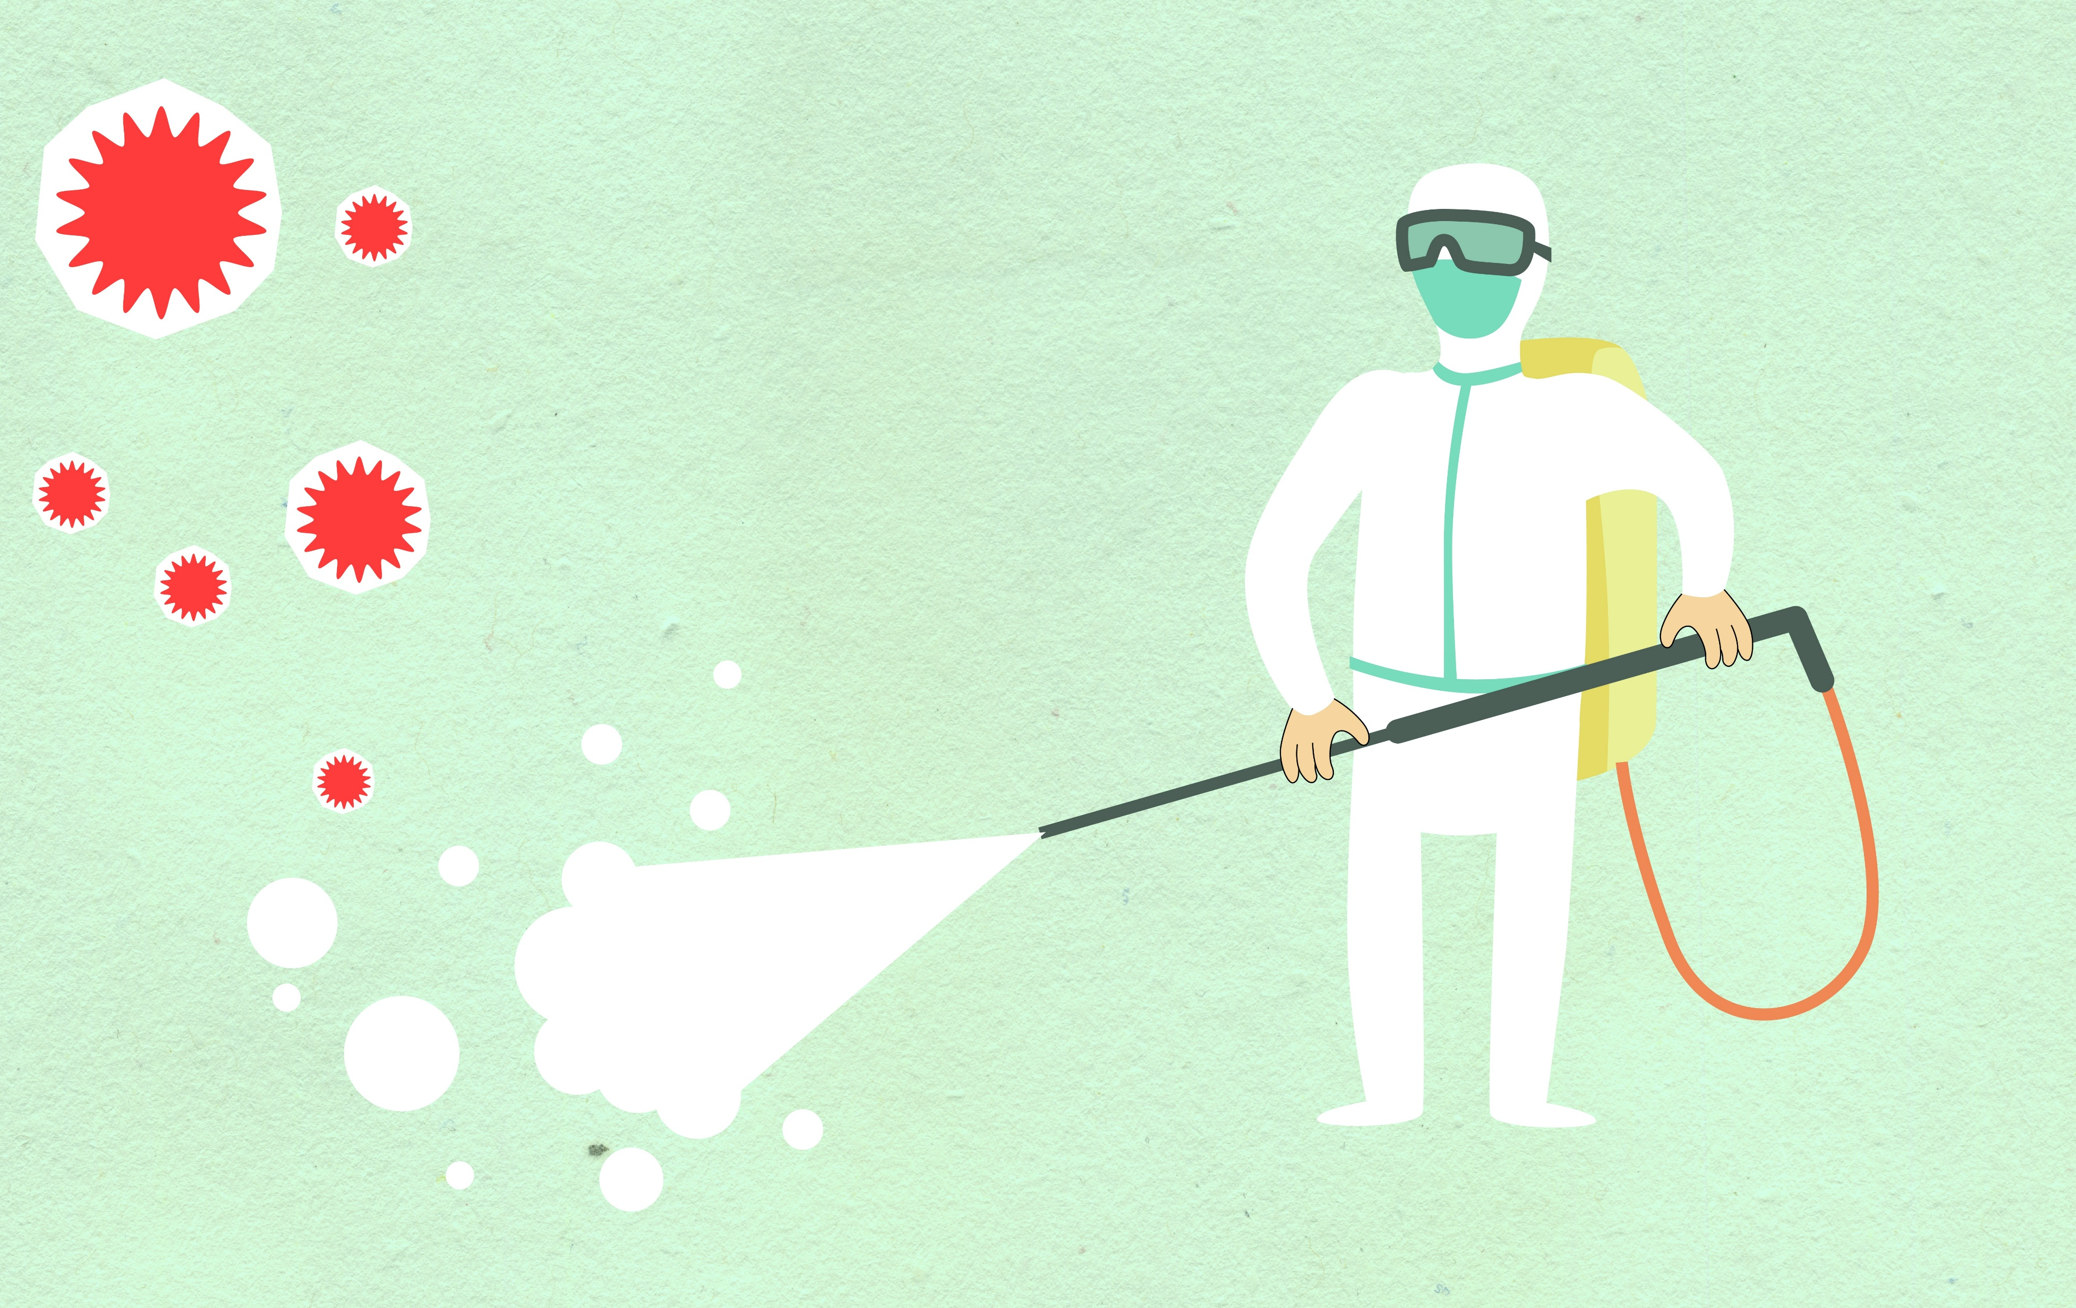
3.4 Minimise Contamination of People, Materials and Equipment

Slide 23
3.4.1 Control Measures to Minimise Contamination of People
Here are some examples of control measures you may do to reduce human contamination:
Identifying clean and contaminated zones
Managing clean and contaminated zones
Placing appropriate health and safety signs
Respond to Potential and Actual Exposure to Infection Risks Within Scope of Own Role

Slide 24
Identifying Clean and Contaminated Zones
A clear separation between the clean and contaminated zones of a workplace should be observed to prevent the accidental spread of infection.
Maintaining Clean and Contaminated Zones
Maintain clean and contaminated zones by doing the following:
Limiting interactions within the contaminated zone’s space
Decontaminating the space as soon as possible
Respond to Potential and Actual Exposure to Infection Risks Within Scope of Own Role

Slide 25
Placing Appropriate Health and Safety Signs
Signs to identify procedures or actions usually follow this colour coding:
DO NOT – Red circle and slash signs show that an activity is prohibited
MUST DO – Blue circle signs show the PPE that should be worn
BE AWARE – Yellow triangle signs warn about hazards in the area
INFORMATION – Green square signs show information on emergency safety
Respond to Potential and Actual Exposure to Infection Risks Within Scope of Own Role

Slide 26
3.4.2 Control Measures to Minimise Contamination of Equipment and Materials
Here are some examples of contamination control procedures for equipment and materials:
Washing materials, equipment, and instruments in the designated area only
Keeping the water pressure low
Using appropriate cleaning materials
Cleaning and drying surfaces thoroughly
Respond to Potential and Actual Exposure to Infection Risks Within Scope of Own Role

Slide 27
3.4.3 Implementing Control Measures to Minimise Contamination
Consider the following control measures to minimize contamination:
Identify potential and actual exposure to infection risks
Come up with measures that correspond to the hierarchy of control
Pick a preferred control option
Respond to Potential and Actual Exposure to Infection Risks Within Scope of Own Role

Slide 28
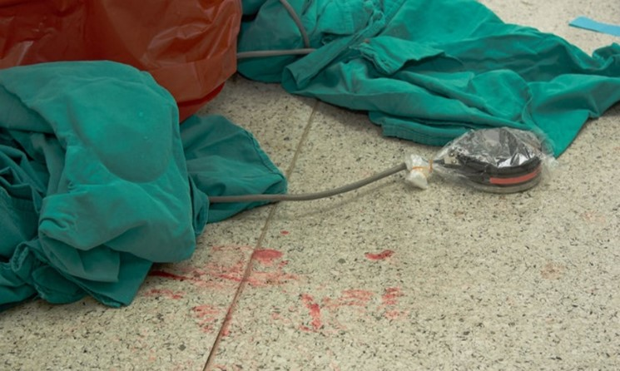
3.5 Manage Spills and Exposure to Blood or Body Fluids

Slide 29
3.5.1 Follow Processes for Management of Spills
Generally, the processes for spill management would look like this:
Gather the spill kit.
Wash your hands.
Put on gloves and an apron.
Contain the spill using absorbent agents or paper towels.
Scoop up the spill and dispose of it in clinical waste bags.
Clean the area.
Respond to Potential and Actual Exposure to Infection Risks Within Scope of Own Role

Slide 30

Generally, the processes for spill management would look like this:
Remove gloves and the disposable apron.
Dispose of used PPE in clinical waste bins or bags
Keep used materials in their own container.
Wash your hands.
Report the incident to a supervisor.
Respond to Potential and Actual Exposure to Infection Risks Within Scope of Own Role

Slide 31
3.5.2 Follow Processes for Management of Exposure to Blood or Body Fluids
Exposure happens if there is direct skin contact with blood or bodily fluids that provide a risk of bloodborne virus transmission.
Exposure can also occur when blood or bodily fluids come into touch with an open cut, abrasion, or dermatitis in the skin.
The same thing happens when there is direct contact with the mucous membrane.
Respond to Potential and Actual Exposure to Infection Risks Within Scope of Own Role

Slide 32

Here's an example of a method to conduct after being exposed to blood or bodily fluids:
Immediate care
Risk assessment
Follow-up
Respond to Potential and Actual Exposure to Infection Risks Within Scope of Own Role

Slide 33

3.6 Document and Report Incidents and Responses

Slide 34
Infection-Related Incidents and Responses
Below are examples of infection-related responses:
Analysing risks to respond to a potential breach in infection control
Communicating with a supervisor, manager, or relevant authority when there is potential or actual exposure to infection risks
Applying transmission-based precautions when there is a suspected or confirmed outbreak of infection
Respond to Potential and Actual Exposure to Infection Risks Within Scope of Own Role

Slide 35
3.6.1 Documenting Infection-Related Incidents and Responses
Documents are key information sources. You must ensure that they include the following:
What happened
When it happened
Where it happened
How it happened
Respond to Potential and Actual Exposure to Infection Risks Within Scope of Own Role

Slide 36
Adhere to the following process when documenting infection-related incidents and responses:
Access the appropriate incident form
Make sure you have authorisation to enter information in the document and record
Make sure that you enter correct information
Respond to Potential and Actual Exposure to Infection Risks Within Scope of Own Role

Slide 37
3.6.2 Report Infection-Related Incidents and Responses
Infection-related incidents and responses might be reported in writing or verbally.
The individuals you report to are the same persons with whom you communicate:
Supervisor
General practitioner
Health care professional
Carer
Responsible person
Responsible authority
Respond to Potential and Actual Exposure to Infection Risks Within Scope of Own Role

Slide 38
Here's an example of a process for reporting:
Verbally report the incident to a designated person.
Provide the details you know about the incident.
Seek advice on the next steps you can take to respond to the incident.
Respond to the incident following the designated person's advice.
Document the incident and response using the incident report form.
Submit the completed incident report form following workplace procedures.
Report to a WHS regulator.
Respond to Potential and Actual Exposure to Infection Risks Within Scope of Own Role

Slide 39

Do the following when reporting incidents:
Provide an overview of the incident.
Identify the people involved in the incident.
Describe the condition of who was involved in the incident.
Describe the status of any equipment.
Respond to Potential and Actual Exposure to Infection Risks Within Scope of Own Role

Slide 40

3.7 Store Records, Materials and Equipment in the Designated Area

Slide 41

Ensuring Records and Non-contaminated Materials and Equipment Are Stored in a Well-Designated Clean Zone
Records must be stored in containers free of splat, dust, aerosols, and droplets in order to remain intact.
Drawers and shelves, for example, must be correctly labelled and closed.
Materials and equipment that have not yet been used or steriled must be stored in a clean room to avoid infection.
Respond to Potential and Actual Exposure to Infection Risks Within Scope of Own Role

Slide 42
Here are some things the workplace may do to guarantee that these items are kept in a well-designated clean zone:
Make sure that people in the workplace know about the designated clean zone
Set rules about how to enter and exit the clean zone
Place appropriate signs to indicate the location is designated clean zone
Return only non-contaminated records, materials and equipment
Respond to Potential and Actual Exposure to Infection Risks Within Scope of Own Role

Slide 43
Store Contaminated Instruments and Equipment in a Well-Designated Contaminated Zone
Do the following when storing contaminated instruments and equipment in a contaminated zone:
Set clear boundaries for the contaminated zone.
Consider all items in a contaminated zone as contaminated.
Control the movement of people and items.
Respond to Potential and Actual Exposure to Infection Risks Within Scope of Own Role

Slide 44
Do the following when storing contaminated instruments and equipment in a contaminated zone:
Decontaminate items leaving a contaminated zone.
Discarded PPE into appropriate waste containers.
Respond to Potential and Actual Exposure to Infection Risks Within Scope of Own Role

Slide 45

What have we learnt?
In this part of the session, we have covered:
Identify the role of infection prevention and control in the work setting
Follow standard and transmission-based precautions for infection prevention and control in the work setting
Respond to potential and actual exposure to infection risks within scope of own role

Slide 46
End of Chapter 3

Slide 47

Presentation Objectives
Now that you have completed this presentation, you should be able to:
Identify the role of infection prevention and control in the work setting
Follow standard and transmission-based precautions for infection prevention and control in the work setting
Respond to potential and actual exposure to infection risks within scope of own role

Slide 48
End of HLTINF006 Presentation

Slide 49
Version Control & Document History
Date | Summary of Modifications | Version
25 January 2023 | Version 1.0 released for publishing | 1.0
14 April 2023 | Version 1.1 endorsed for use Minor revisions for improved readability | 1.1
25 May 2023 | Version 1.2 endorsed for use Modified some discussions in Section 2.2.2 Fixed minor wording issues | 1.2

